Slide 1

Joystick 0 Controls
Left Bumper: Defensive Pivot
Left Trigger: Fire Control Override
Right Bumper: Toggle Intake Deploy
Right Trigger: Auto-Targeting
Y axis(north/south): Strafe Front/Back
X axis(east/west): Strafe Port/Starboard
Press button: Emergency Boost
Feeder Station Mode
Enter Robot Oriented
Clear Errors
Enter Field Oriented
Signal Human Player
Reset IMU
Rotate Drive Base
Rumbles: Auto-Targeting
Written by Amelia and Amelie

Slide 2
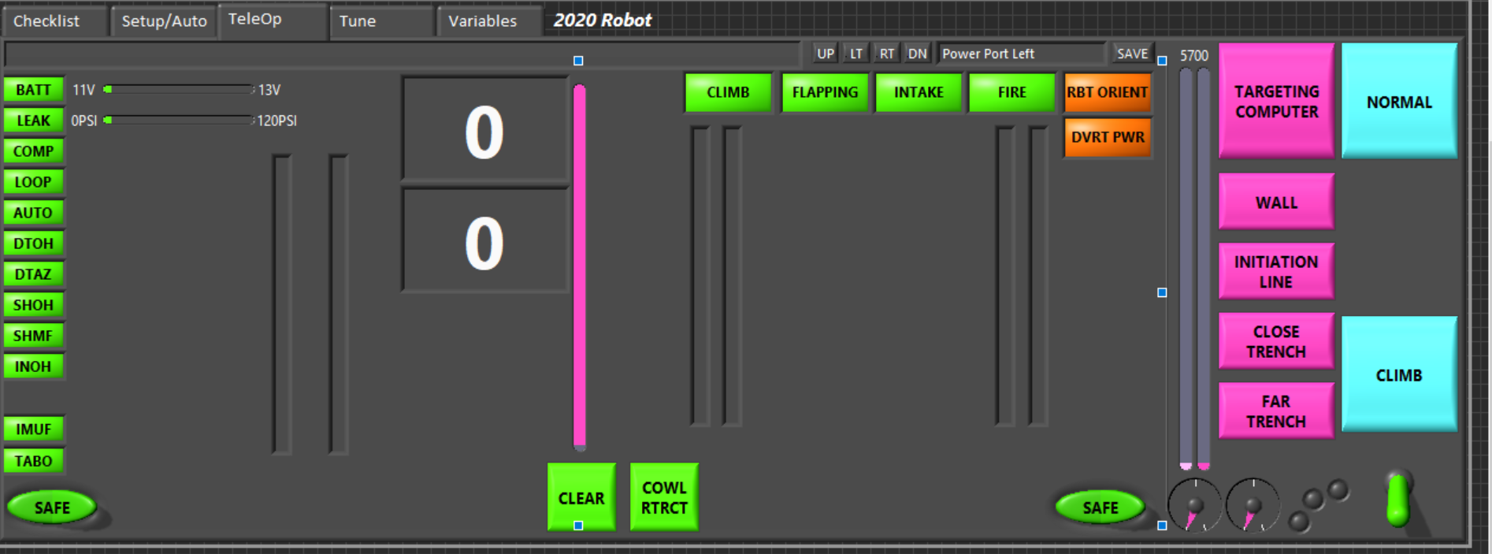

Slide 3
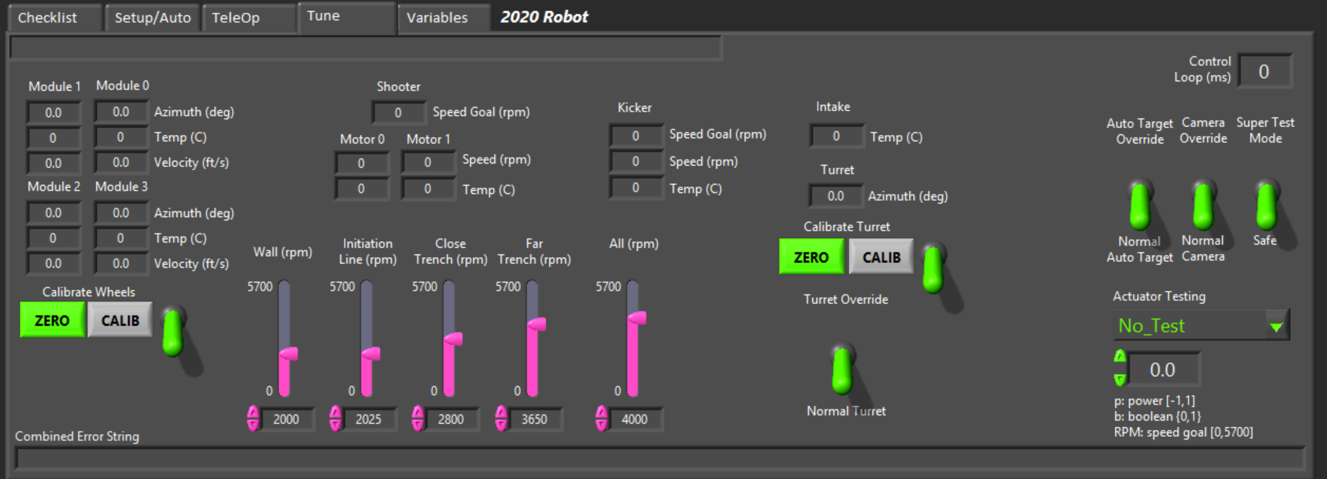

Slide 4
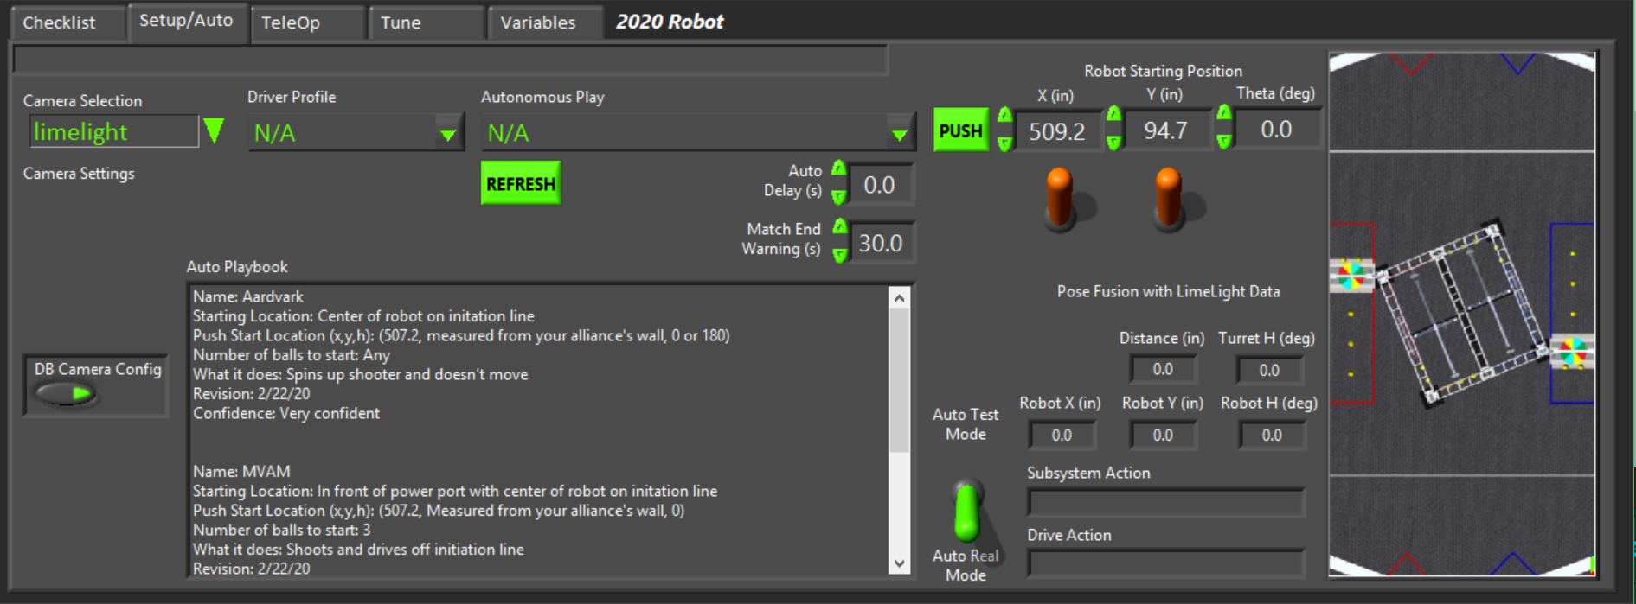

Slide 5
BeleBop Bab
Power port line up
Robot/Field oriented
Battery low
Battery Voltage
Pressure
Match Timer
Balls Shot
Climber climbing
Flapper flapping
Intake intaking
Shooter shooting
Divert Power (battery saving)
Pressure leak
Shooter Mode
Compressor on
Loop times
(Don’t worry about it)
Bad auto file
(Technician messed up)
Drivetrain overheated
Drivetrain azimuth failure
Shuts module down
Shooter overheated
Climb buttons (Click switch before button)
Shooter motor failure
Intake overheated
IMU Failure
Goes into robot oriented
And turns off auto-targeting
Distance from Target
Clear Errors: Click before going into safety overrides to see if the problem goes away
Master Safety Override Button 2 (need both)
Cowl Position
Master Safety Override Button 1 (need both)
Emergency Cowl Retract
Shooter Power and Goal
Tablet Override w/ 2nd joystick
Kicker Power
Yellow: Intake line up
Orange: Feeder Station line up

Slide 6
Turns auto targeting off: if the IMU or camera is bad or if autotargeting doesn’t work
Camera override: Just shows LL, only uses field position for auto targeting
Test Code: Select the actuator you want to test. Enter the value you want to send. (P) means power, so input [-1,1]. (b) means Boolean so input {0,1}. RPM needs an input of [0,5700]
Change set point for shooter for the various modes
Zero moves swerve modules to 0 and calibrate sets current position to default

